Slide 1
Internet Routing Architectures
張燕光
成大資工

Slide 2
Outline
1 Internet Routing Evolution
2 Addressing and Routing: Illustrations
2.1 Routing Packet: Scenario A
2.2 Routing Packet: Scenario B
2.3 Routing Packet: Scenario C
3 Current Architectural View of the Internet
3.1 Customers/Providers, Peering/Tiering, and Exchange Points
3.2 A Representative Architecture
3.3 Customer Trafﬁc Routing: A Geographic Perspective
3.4 Size and Growth
4 Allocation of IP address Preﬁxes and AS Numbers

Slide 3
1 Internet Routing Evolution
Until the early 1980s, the ARPANET served the role of interconnecting various sites with a rigid two-level hierarchy where the ARPANET nodes were at the top level.
In 1983, ARPANET was split into two networks: APRPANET and MILNET.
Two separate networks talking to each other in case one host in one network wants to communicate with another host in the other network, and vice versa.

Slide 4
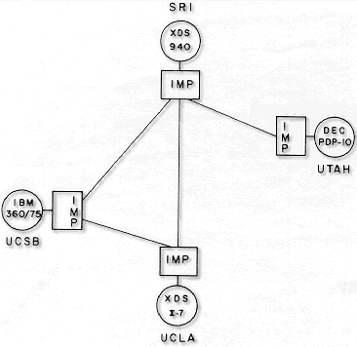
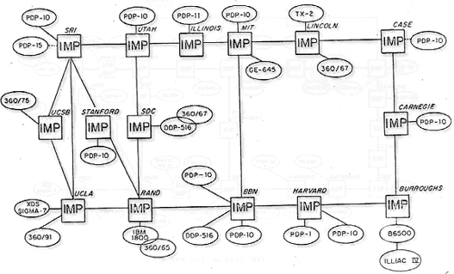
1969
1971

Slide 5
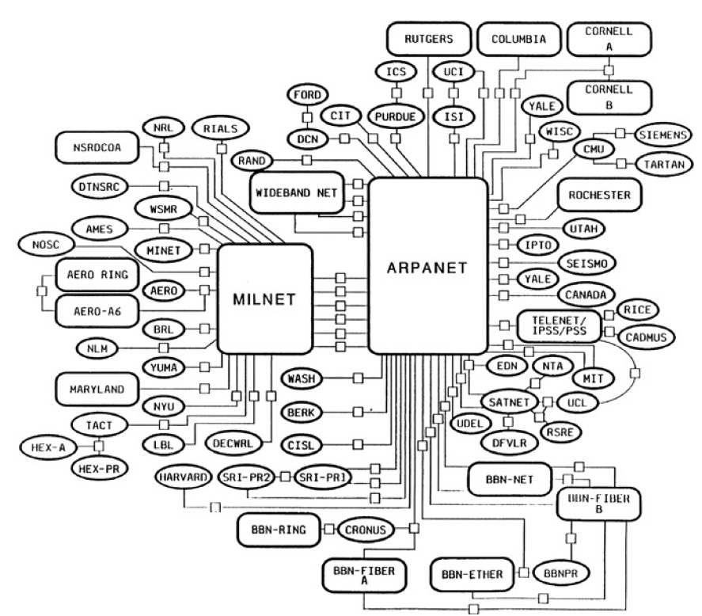
1983

Slide 6
1 Internet Routing Evolution
Exterior Gateway Protocol (EGP), developed in 1982-1984 describes how separate networks that are autonomous can talk to each other.
EGP defined a two-level strict hierarchy with the top level labeled as the core back bone and the bottom level being the level at which the different networks, defined through ASes, were connected.
the term autonomous system (AS) and the notion of a 16-bit autonomous system number (ASN) were introduced.

Slide 7
1 Internet Routing Evolution
NSFNET developed first in 1984 relied on EGP.
In EGP, non-backbone ASes were not allowed to be directly connected, due to the strict two-level hierarchy.
Furthermore, unlike BGP, EGP messages were sent directly over IP without invoking any reliable transport protocol.

Slide 8
1 Internet Routing Evolution
In essence, while EGP provided a much needed transitional platform to go from the ARPANET to the NSFNET, it had several restrictions not desirable for longer term growth.
EGP did not allow ASes to be directly connected. A network located in an AS needs to go through the top level (NSFNET) to reach another network in another AS.
NSFNET faced the situation that certain networks that belonged to different ASes had backdoor connectivity.
Thus, EGP’s strict requirement could not be directly applied or enforced in the NSFNET.

Slide 9
1 Internet Routing Evolution
EGP and, particularly, NSFNET experiences led to the recognition that any future routing architecture must be able to handle policy-based routing, and any newly developed exterior gateway protocol must have ability to handle policy decisions.
This experience and realization served as the impetus to the development of BGP, which was first introduced in 1989 through RFC 1105.

Slide 10
1 Internet Routing Evolution
To summarize, BGP addresses following issues:
Avoiding a strict two-level hierarchy like EGP
Allowing multiple levels such that any AS has the option to connect to another AS
Using TCP for reliable delivery of BGP data
Making policy-based routing possible

Slide 11
1 Internet Routing Evolution
By 1991, BGP was expanded to BGP version 3 (BGP3).
classful addressing: implicit address block classification under Class A, Class B, and especially Class C, causes a significant growth of routing table entries at backbone routers;
thus, avoid/minimize assigning address block straight at Class C were needed.
This has led to consider address aggregation through supernetting, which subsequently led to the development of classless interdomain routing (CIDR).

Slide 12
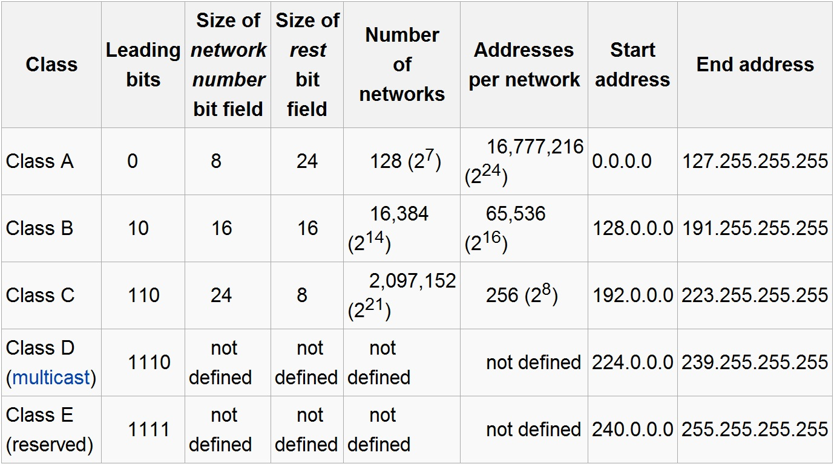
IPv4 Subnet Classes

Slide 13
1 Internet Routing Evolution
BGP version 4 (BGP4) has resulted in several improvements over BGP version 3 since 2006 ,
The use of CIDR was one of the most signiﬁcant changes that required communicating netmask information to be advertised along with an IP address block during a BGP announcement.

Slide 14
2 Addressing and Routing
Routing in the Internet is fundamentally impacted by IP addressing.
The address family is known as IPv4, and its recent version is known as IPv6.
focus on IPv4 addressing.
The IPv4 32-bit address is typically written in dotted decimal format, A.B.C.D.

Slide 15
2 Addressing and Routing
contiguous addresses for a specific network, 192.168.1.0/8=192.168.1.0 to 192.168.1.255
“0” address 192.168.1.0, will be reserved to identify subnet and “255” address 192.168.1.255 will be reserved as broadcast address.
Originally, IPv4 unicast addressing was allocated through implicit bit boundaries for network block addresses at an 8-bit, 16-bit, and 24-bit boundary, known as Class A, Class B, Class C addresses, respectively.

Slide 16
2 Addressing and Routing
The difficulty with implicit boundary, at least for routing purpose, is that at the 24-bit level boundary, # of address blocks (2²⁴) is too huge to handle if all were advertised!
Instead of the implicit network boundaries at an 8-bit, 16-bit, and 24-bit level, referred to as classless inter-domain routing (CIDR) were found to be more flexible in reducing the need to assign IP address.
Notes:
If all 24-bit network address blocks are to be considered, then we need 224 entries for a routing decision
due to flat addressing.
CIDR :是一個用於給使用者分配IP位址以及在網際網路上有效地路由IP封包的對IP位址進行歸類的方法

Slide 17
2 Addressing and Routing
In CIDR, an explicit net masking defines the network where this host resides.
if the host that we want to reach is 192.168.40.49, and the address block is netmasked at the 21-bit boundary level, all a router needs to know is that 192.168.40.49 is identified as being on a network defined on the 21-bit boundary.
32
8
192.168.40.* … 192.168.47.*
Notes:
If all 24-bit network address blocks are to be considered, then we need 224 entries for a routing decision
due to flat addressing.
CIDR :是一個用於給使用者分配IP位址以及在網際網路上有效地路由IP封包的對IP位址進行歸類的方法

Slide 18
2 Addressing and Routing
when a host with IP address 10.6.17.14 in a network wants to send a packet to 192.168.40.76, it needs to send to network 192.168.40.0/21 which knows how to handle the delivery to the final host.
This is analogous to the postal system.
Question: how does the originating host know how to get the packet out of its own network so that it can traverse the global Internet toward its destination.
Notes:
If all 24-bit network address blocks are to be considered, then we need 224 entries for a routing decision
due to flat addressing.
CIDR :是一個用於給使用者分配IP位址以及在網際網路上有效地路由IP封包的對IP位址進行歸類的方法

Slide 19
2.1 Routing Packet: Scenario A
Considers routing inside a subnet defined by an IP address block through a standard subnet masking.
192.168.40.49 → 192.168.40.76 in 192.168.40.0/24
Assume subnet mask for this subnet is 255.255.255.0 that is indicated in the configuration profile of these two hosts
Notes:
consider sending a packet from a host with IP address 192.168.40.49(“49ers”) to another host with IP address 192.168.40.76 (“76ers”).

Slide 20
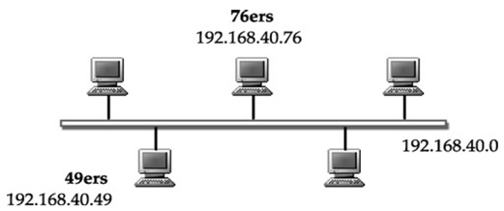
2.1 Routing Packet: Scenario A
The Address Resolution Protocol (ARP) maps the IP address to the Ethernet address.
Notes:
Through this process, Host “49ers” finds the Ethernet address of the destination IP address192.168.40.76(76 ers).
Once the Ethernet address of the destination is determined, the packet is sent as an Ethernet frame with the destination address set to this Ethernet address.

Slide 21
2.2 Routing Packet: Scenario B
This scenario is where communication is not limited to the same subnet, but it is in the same network.
To make correct destination in different subnet, the host must be equipped with a default gateway address
for handling such packet arrival.
default gateway address : if a packet’s destination is not on the same subnet, the default gateway will be the agent that will be the recipient of this packet.
Notes:
default gateway : will be the agent that will be the recipient of this packet, which, in turn, hopefully knows how to handle it.
LSA描述了所有的鏈路，接口和鄰居等鏈路狀態信息，OSPF路由協議對所有路由信息的描述，都是封裝在鏈路狀態通告LSA中發送出去的。
Router LSA的主要內容是：產生這條Router LSA的路由器連接了幾條Link。

Slide 22
2.2 Routing Packet: Scenario B
The default gateway is known to the sending host either by static configuration or through the Dynamic Host Configuration Protocol (DHCP).
In general, the following must hold for a host to communicate on the Internet:
Either through static configuration or DHCP, a host must
have three key pieces of information: host IP address,
subnet mask, and default gateway.
For a host to use Internet services, it is also required to have information from a DNS server Thus, a host requires four pieces of information: its host IP address, the subnet mask, the default
gateway , and a DNS server’s IP address.

Slide 23
2.2 Routing Packet: Scenario B
Each router can learn about different subnets from a link state advertisement (LSA) that would contain subnet information with mask by using the network link-type LSA.
link state advertisement : is a basic communication means of the OSPF routing protocol for the Internet Protocol (IP).
Open Shortest Path First (OSPF) : is a routing protocol for Internet Protocol (IP) networks. It uses a link state routing algorithm and falls into the group of interior routing protocols, operating within a single autonomous system.

Slide 24
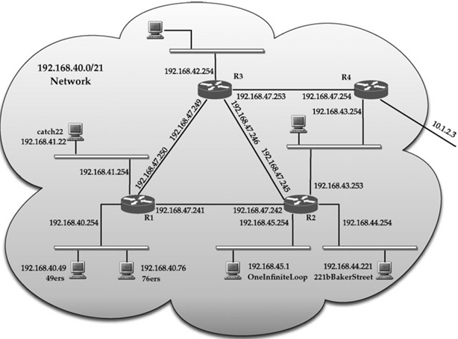
2 Routing Packet: Scenario B
40=00101000
42
Border
router
.40 to .47
en0
sl2
sl0
en0
sl1
sl1
sl0
43
41
en1
sl2
sl0
en2
en0
sl1
sl1
en0
en1
40
45
44
Notes:
consider sending a packet again from Host “49ers,” with IP address 192.168.40.49 and subnet mask 255.255.255.0, to a third host with IP address 192.168.41.22 (“catch22”).

Slide 25
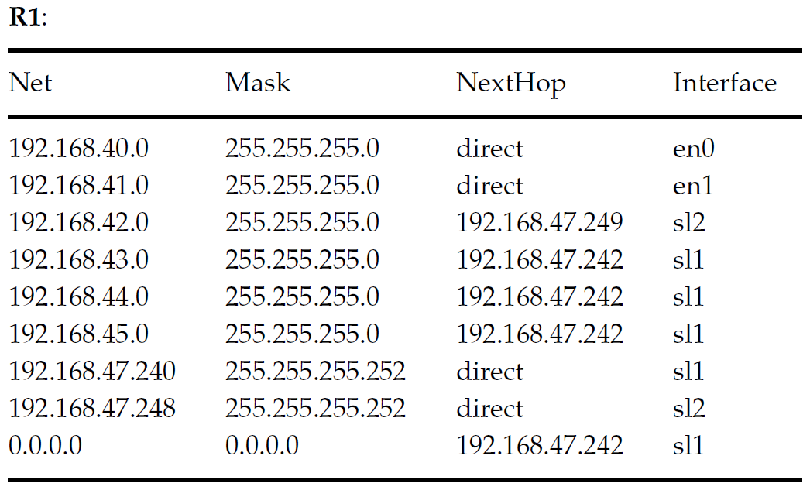
2.2 Routing Packet: Scenario B -Example 1:Host 49ers to catch22
FIGURE 4 Routing tables(with interfaces) at routers in Network 192.168.40.0/21
Notes:
Example 1:Host 49ers to catch22

Slide 26
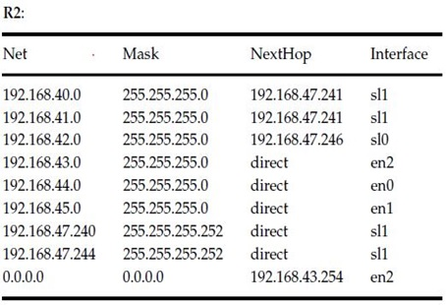
2.2 Routing Packet: Scenario B
FIGURE 4 Routing tables(with interfaces) at routers in Network 192.168.40.0/21

Slide 27
2.2 Routing Packet: Scenario B
FIGURE 4 Routing tables(with interfaces) at routers in Network 192.168.40.0/21

Slide 28
2.2 Routing Packet: Scenario B
192.168.40.49/24 → 192.168.41.22/24
Notes:
Consider sending a packet again from Host “49ers,” with IP address 192.168.40.49 and subnet mask 255.255.255.0, to a third host with IP address 192.168.41.22 (“catch22”). Note that Host “49ers” does not know about
the subnet mask of Host “catch22.” Based on its own subnet mask, Host “49ers” compares and determines that Host “catch22” is on a different subnet, 192.168.41.0

Slide 29
2 Routing Packet: Scenario B
42
en0
sl2
sl0
en0
sl1
sl1
sl0
43
41
en1
sl2
sl0
en2
sl1
sl1
en0
en0
en1
40
45
44
Notes:
consider sending a packet again from Host “49ers,” with IP address 192.168.40.49 and subnet mask 255.255.255.0, to a third host with IP address 192.168.41.22 (“catch22”).

Slide 30
2.2 Routing Packet: Scenario B -Example 2: Host 49ers to 221bBakerStreet
Notes:
Example 2: Host 49ers to 221bBakerStreet

Slide 31
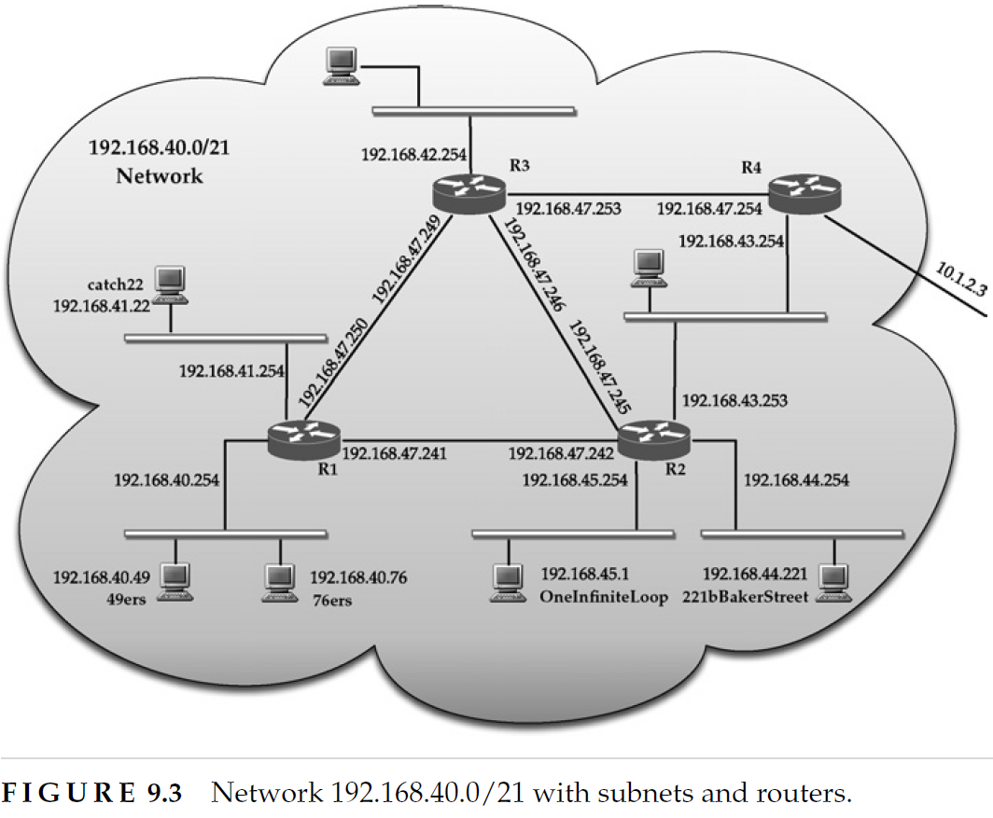
2.2 Routing Packet: Scenario B -Example 2: Host 49ers to 221bBakerStreet
Notes:
This packet will first arrive at router R1 since by inspecting the address of Host “221bBakerStreet”
At router R1, by inspecting the routing table, the packet would be forwarded to router R2, whereupon it will be sent on the Ethernet interface with IP address 192.168.44.254.

Slide 32
2.2 Routing Packet: Scenario B
Learning about different subnets within domain can be accomplished using OSPF flooding.
Learning by a LSA containing subnet info with mask by using the network link-type LSA.
Once announcements about various subnets are received, each router can use shortest path routing to determine the appropriate next hop to reach different subnets.

Slide 33
2.2 Routing Packet: Scenario B
Note that each table contains a 0.0.0.0/0 entry, which is referred to as the default route.
default route : similar to the default gateway maintained by each host; this entry points to a next-hop for forwarding a packet that lists a destination not listed in the routing table.

Slide 34
2.3 Routing Packet: Scenario C
Route a packet generated at Host “49ers” to a host (10.5.16.60) outside of network 192.168.40.0/21, where each network is served by a different Autonomous System(AS).
Autonomous System : is a collection of connected Internet Protocol (IP) routing prefixes under the control of one or more network operators on behalf of a single administrative entity or domain.

Slide 35
2.3 Routing Packet: Scenario C -example : Host 49ers to 10.5.16.60(in AS)
Notes:
Using the next hop for default route at each router, the packet generated at Host “49ers” would be forwarded from R1 to R2 to R4.
Note that R4 is the border router in this domain that can speak OSPF to interior routers, but can also speak BGP to its peering EBG speaker and 10.1.2.3 is the next hop of default route in R4.

Slide 36
2 Routing Packet: Scenario B
42
en0
sl2
sl0
en0
sl1
sl1
sl0
43
41
en1
sl2
sl0
en2
sl1
sl1
en0
en0
en1
40
45
44
Notes:
consider sending a packet again from Host “49ers,” with IP address 192.168.40.49 and subnet mask 255.255.255.0, to a third host with IP address 192.168.41.22 (“catch22”).

Slide 37
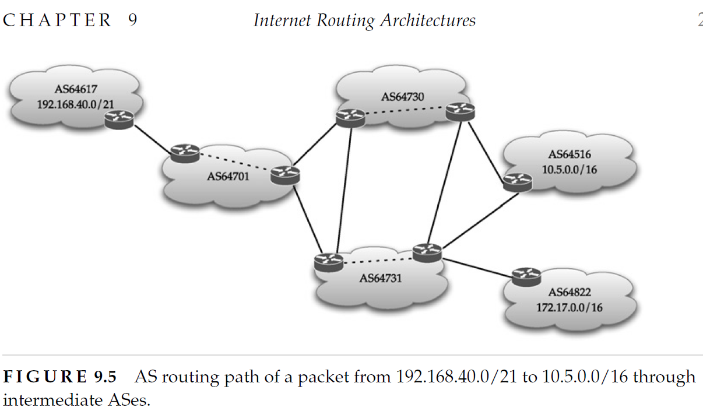
2.3 Routing Packet: Scenario C -example : Host 49ers to 10.5.16.60 (between ASes)
Notes:
By using the next hop for the default route at each router, the packet generated
at Host “49ers” would be forwarded from R1 to R2 to R4.

Slide 38
2.3 Routing Packet: Scenario C
We have assumed that default route concept is used.
There are certain problems with every AS using the default route to send a packet out of its AS.
EX., if destination host is from an IP address block not yet allocated by Internet registry, the packet would keep hopping from one AS to another until the age field (time-to-live field) in IP packet header expires
Notes:
For example, if the destination host is from an IP address block that has not yet been allocated
by the Internet registry, the packet would keep hopping from one AS to another until the age
field (also known as the time-to-live field) in the IP packet header expires.

Slide 39
2.3 Routing Packet: Scenario C
Two possibilities
At least one of intermediate ASes maintains all default-free entries (no default route entry, 0.0.0.0/0).
The originating AS at its border router maintains the list of all valid IP prefix assigned. So it can filter this packet and drop it, preventing from going into next AS.
A default-free routing table allows an IP packet with a destination in unallocated address blocks from being forwarded further by dropping it.
Transit ASes commonly employ a default-free routing table for such reasons.
Notes:
For example, if the destination host is from an IP address block that has not yet been allocated
by the Internet registry, the packet would keep hopping from one AS to another until the age
field (also known as the time-to-live field) in the IP packet header expires.

Slide 40
2.3 Routing Packet: Scenario C - at least one intermediate AS is default route-free
Transit AS
Transit AS
Transit AS
If AS64701 maintains all default-free routers, the packets from AS64617 sending to a host of unallocated block can be dropped in AS64701.
Notes:
Now, there is no default route entry,0.0.0.0/0.
Here network 172.17.0.0/16 homed in AS64822 would know AS64731, which will share this information with AS64730.
Then, if Host “49ers” in network 192.168.40.0/21 in AS64617 generates a packet to an IP destination that is from an IP address that is not valid, the border router in AS64701 would note this and drop this packet

Slide 41
2.3 Routing Packet: Scenario C - stub AS maintains every valid IP prefix assigned
Stub ASes now maintain a full IP prefix table at their border routers. This can be driven by local needs in a stub AS, to perform unicast reverse-path-forwarding checks as a measure for IP address spoofing.
Border routers should be powerful.
A stub AS is not required to maintain a default-free routing table, it has essentially become a necessity of issues such as spoofing attacks.

Slide 42
2 Summarize
Two types of ASes: stub AS and transit AS.
Stub AS : has only a single border router.
Transit AS : connect to multiple ASes due to either public or private peering.
An AS can also be multihomed.
A multihomed AS connects to two or more transit ASes.
ASes can be classified into three categories:
Singlehomed stub,
Multihomed stub , and
Multihomed transit.

Slide 43
2 Summarize
Routing a packet from a stub AS to another would hop through at least a transit AS.
Any path selection decision at a BGP speaker would be based on the BGP path selection algorithm.
Certainly, before route selection can be invoked about an IP prefix , the BGP UPDATE message would be used to announce this IP prefix ; the AS number is prepended as necessary when the information about this IP prefix crosses from one AS to another.

Slide 44
3.1 Customers and Providers
Customer typically refers to an organization that has an IP address block (IP Prefix).
It relies on a provider for Internet connectivity.
The relationship between customer and provider is hierarchical and is sometimes described also as downstream ISP/upstream ISP relation.
At the top of the hierarchy is tier 1 ISPs.
Each tier 1 ISP has its own AS number.

Slide 45
3.1 ISP connectivity
All tier 1 ISPs are at same peering level.
Tier 1 ISPs meet at network access points (NAPs) to exchange traffic from one network to another.
A tier 1 ISP provides a large network spanning a geographic region (entire country or across countries); such networks are often referred to as Internet backbone networks where link speeds can be in the order of 100 Gbps or higher with the most advanced routers deployed.

Slide 46
3.1 ISP connectivity
NAPs are also known as Internet exchange points (XP, or, EP in short), or Metropolitan Area Exchanges (MAEs).
such arrangements are known as public peering since they are neutral meeting points.
Private peering between two tier n ISPs, serving as a bypass from congested exchange points.
also private peering between two tier n ISPs where they connect directly to each other and agree to exchange traffic with each other, serving as a bypass from congested exchange points, which some ISPs prefer.

Slide 47
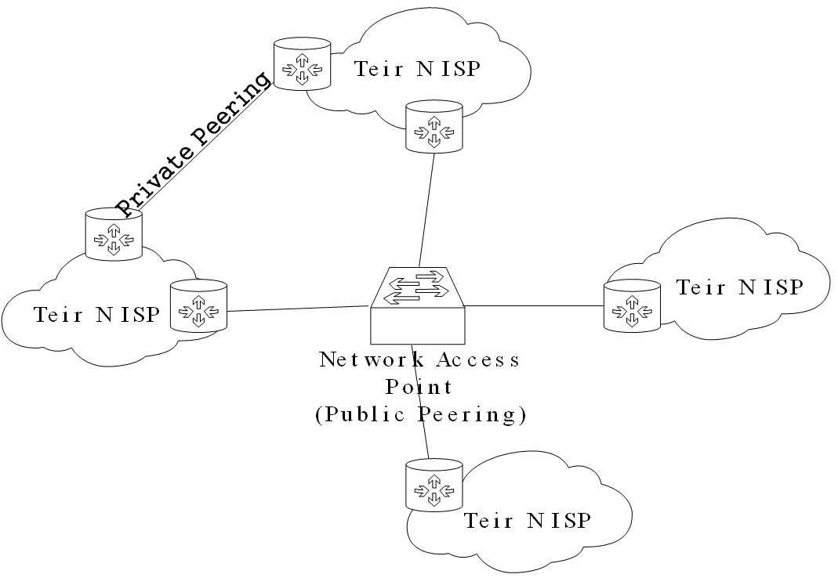
3.1 ISP connectivity
a generic example with four tier 1 ISPs meeting at an NAP.
Tier N ISP
Tier N ISP
Tier N ISP
Tier N ISP

Slide 48
3.1 Physical connectivity
Exchange points provide physical connectivity to customers (Gigabit Ethernet, ATM, SONET), where customers’ routers for connectivity are collocated in the same physical facility.
The difficulty is that the sheer volume of traffic each ISP generates is so high.
In recent years, some exchange points have become popular for Content Delivery Network (CDN) providers since they can be directly connected to various major ISPs.

Slide 49
3.1 Example of Policies for exchanges points
An ISP must have its own AS number and use BGP to become a member of an exchange point.
The exchange point cannot be used for transit.
The exchange point policy requires full peering among all parties, or each ISP can choose a different set of acceptable policies.
It has a flexible policy to let providers of different size to connect to its exchange point allowing each provider to set their own peering restrictions.

Slide 50
3.1 Multiple tiers
It also allows private interconnects between two members.
Tier 1 ISPs (providers) provide connectivity to tier 2 ISPs (customers).
Tier 2 use tier 1 for transit service but may peer with others
A tier 1 ISP provides transit service to many tier 2 providers at certain meeting points that are commonly referred to as Points of Presences (PoPs).
Tier 3 ISPs seek transit service only from either tier 2 or 1.
Tier 3 ISPs typically not involved in public peering, although they may do some private peering.
Tier 4 ISPs require transit connectivity from tier 3 providers.

Slide 51
3.1 Multiple tiers
CDN providers want to be located close to tier 1 ISPs.
They usually have two options:
(1) their web servers host directly on one of the tier 1 ISPs; (no AS number is necessary),
(2) their series of web servers connected through routers to form a network with their own AS number, and then have peering with every major provider at major peering points or through private peering.
If they choose option 2, they do not exactly fall into one of the tiering providers-called content delivery service (CDS) ISPs. CDS ISPs examples: Google, Yahoo!, and Akamai.

Slide 52
3.1 Internet Exchange
No clear rule to indicate who is/isnot a certain tier ISP.
No authority defines tiers of networks in the Internet.
Currently, Deutscher Commercial Internet Exchange (DE-CIX) considered the largest exchange point, has a flexible policy; it lets providers of different size to connect to its exchange point allowing each provider to set their own peering restrictions, including allowing private interconnects between two members.
The second be Amsterdam Internet Exchange (AMS-IX). As in May 2015, DE-CIX/AMS-IX has about 610/710 members; the peak rate is 4/3.7 Tbps and average is 2.5/2.3 Tbps, respectively.

Slide 53
3.2 Three representative sessions
We will illustrate three representative sessions using the architecture.
From user U1 to server S1.
From user U2 to server S2.
From user U3 to server S2.
The original topology that there are multiple paths for each of these sessions.

Slide 54
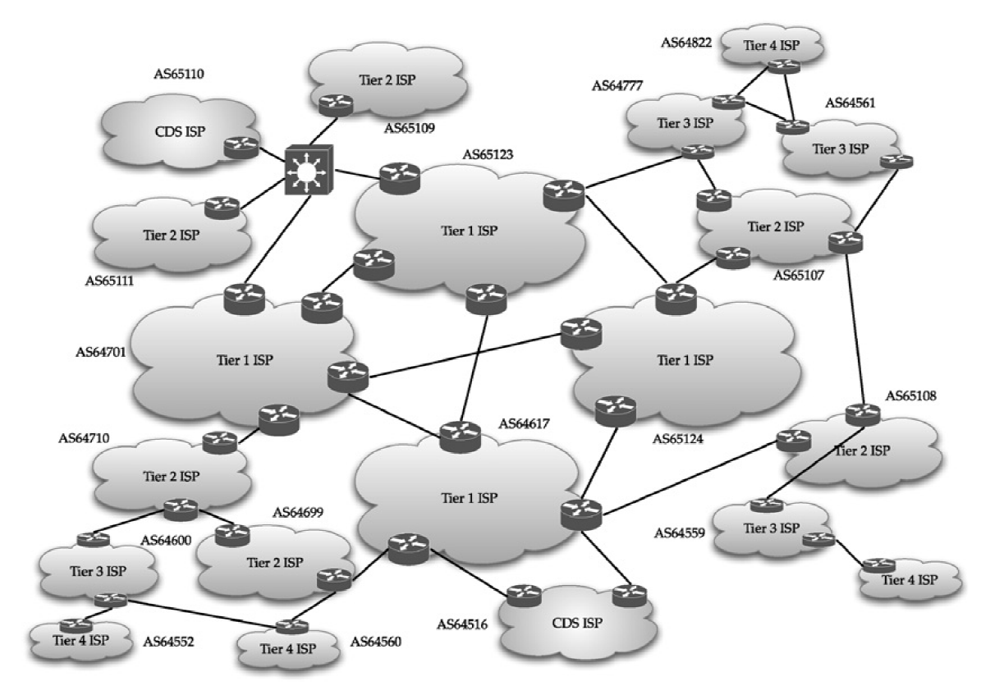

Slide 55
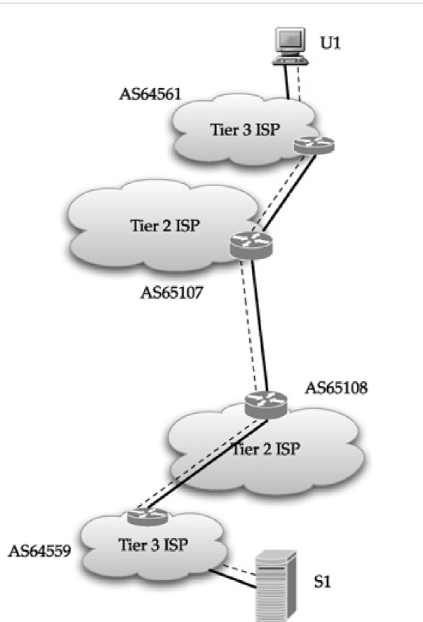
3.2 The session from U1 to S1
There are two AS-paths.
The AS-path with the shorter AS length is chosen since there is private peering between respective pier 2 ISPs.

Slide 56
U1
Take the shortest
path
S1

Slide 57
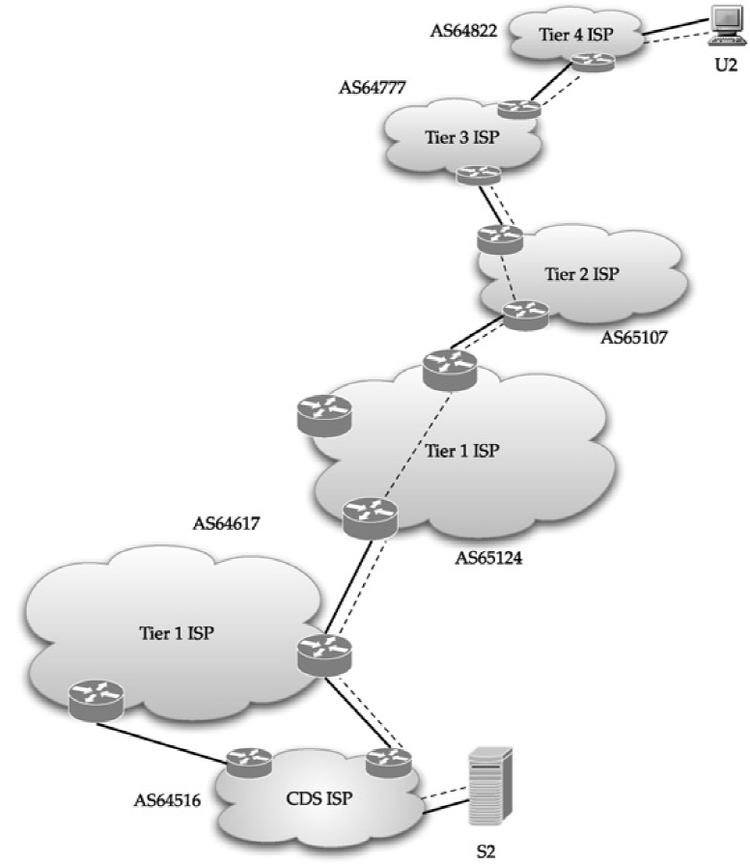
3.2 The session from U2 to S2
appears to be two AS-paths.
The policy at the tier 2 ISP is upstream from U2.
The one through tier 1 ISPs would be taken.

Slide 58
3 Interconnection of ISPs of different tiers
U2
Tier 4 U2 takes
Tier 2 upstream policy
S2

Slide 59
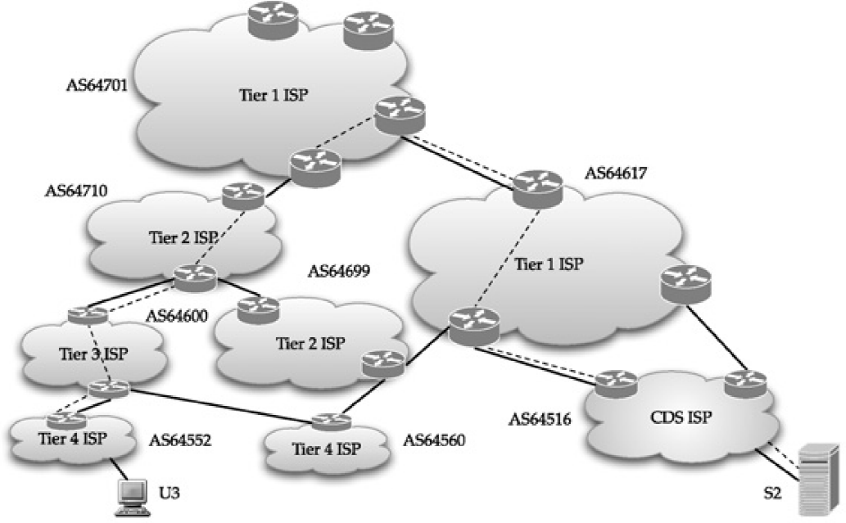
3.2 The session from U3 to S2
Selected path: 552>600>710>701>617>516.
AS64617 multi-connects to AS64516

Slide 60
3.2 The session from U3 to S2
Second path: 552>600>560>699>617>516.
This second path would not be advertised.
AS64560, a tier 4 ISP, will learn about AS64516 from AS64699, this would not be advertised to tier 3 provider AS64600.
Due to stub rule: AS54552 and AS64600 would not know about the connectivity between AS64600 and AS64560.

Slide 61
3 Interconnection of ISPs of different tiers
U3
S2

Slide 62
3.2 Observations of the session
In the case of server S2 located in CDP ISP (AS64516), it is multi-connected to tier 1 ISP AS64617.
AS64617 chooses one egress point depends on early-exit routing rule. (will be discussed later)
From the perspective of the tier 1 ISP, it has multiple egress points to the CDP ISP AS64516.

Slide 63
3.2 Observations of the session
U2 is a user in a tier 4 ISP (AS64822), which is a stub AS.
AS64822 is dual-homed from a single BGP speaker to two different tier 3 ISPs, AS64777 and AS64561.

Slide 64
3.2 Observations of the session
The tier 4 ISP AS64822 has a couple of different options to prefer accessing one tier 3 ISP over the other:
Set the local pre-configured priority values to access AS64777, as opposed to the other, since this factor is given higher priority in the BGP route selection process.
Insert its AS number (AS64822) more than once when advertising IP prefixes it houses to the ISP with the less preferred route (AS64561).

Slide 65
3.2 Observations of the session
A stub AS learns about outside IP prefixes from BGP UPDATE messages it receives from both its tier 3 providers.
It should not advertise what it learns from one to the other.

Slide 66
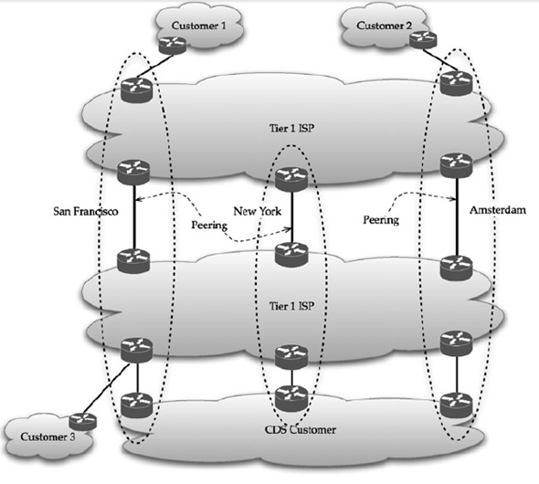
3.3 Customer Traffic Routing

Slide 67
3.3 Customer Traffic Routing
In the Figure, two different tier 1 ISPs span in three different locations:
San Francisco,
New York, and
Amsterdam.
Customers 1 and 3 locate in San Francisco
Customer 2 locates in Amsterdam
A fourth customer of CDS type connects to a tier 1 ISP at all three locations.

Slide 68
3.3 Between Customer 1 and 3
Traffic from customer 1 to 3 transfers through the tier 1 ISPs in San Francisco because both customers are in SF.
If the tier 1 ISPs were not to have peering at San Francisco, the traffic between customer 1 and 3 would transfer in New York.

Slide 69
3.3 Between Customer 2 and 3
Traffic between customer 2 and 3 would transfer at Amsterdam to the other tier 1 provider, known as early-exit routing.
Early-exit routing is not necessarily a problem if both the tier 1 providers have an agreement in place.

Slide 70
3.3 Between CDS and others
Requests from users in Customer 1’s network would be directly handled off to the CDS customer in San Francisco
Requests from users in Customer 2’s network would be handed off in Amsterdam

Slide 71
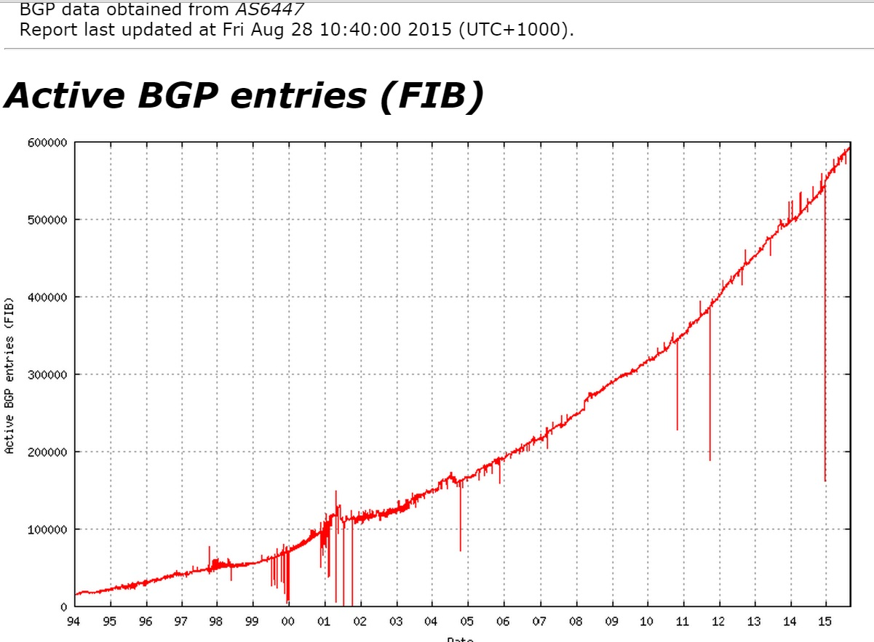
3.4 Size (http://bgp.potaroo.net/as6447/)
593,253

Slide 72
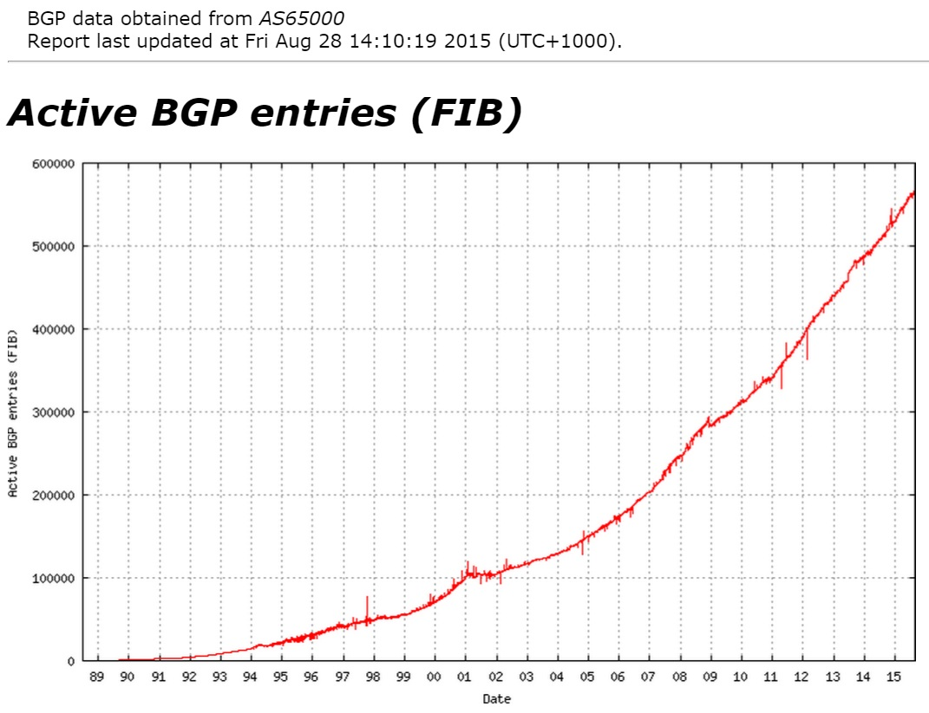
3.4 Size (http://bgp.potaroo.net/as2.0/bgp-active.html)
565,818

Slide 73
3.4 Size

Slide 74
4 Allocation of IP Preﬁxes and AS Number
Internet Corporation for Assigned Names and Numbers (ICANN) is the organization that distributing IP address block to ﬁve different Regional Internet Registries (RIRs).
North American region → American Registry for Internet Numbers (ARIN)
European and the West Asian region → Réseaux IP Européens (RIPE)
South/East Asian and the Paciﬁc region → Asia Paciﬁc Network Information Centre (APNIC)
Latin and South American region → Latin American and Caribbean Internet Address Registry (LACNIC)
African region → African Network Information Center (AfriNIC)

Slide 75
4 Allocation of IP Preﬁxes and AS Number
Each registry has its own rules and pricing in regard to IP address block allocation; this allocation depends on allocation size as well, as indicated through netmask boundary such as /19.

Slide 76
4 Allocation of IP Preﬁxes and AS Number
For example, ARIN’s current policy is that the minimum allocation size is a /20, while for multihomed organizations, the minimum allocation size is a /22. This means that if an organization needs only a /24 allocation, it cannot obtain it directly from ARIN.

Slide 77
4 Allocation of IP Preﬁxes and AS Number
Instead, it must obtain it from an upstream ISP (provider) who has been already allocated at least a /20 address block by ARIN. Similarly, registries put restrictions on allocation of an AS number.

Slide 78
* IPv4 address exhaustion
IPv4 exhaustion doesn’t mean that the Internet will stop working.
IPv4 address exhaustion.ppt

